Slide 1
R Clinic
Session 10:
Further data visualisation in R
Please sit in the first two rows!
All other machines are running an outdated version of R

Slide 2
REMINDER: write down your email address for access to the Dropbox with slides and code.
We will be in this room until beginning of August.

Slide 3
Swirl
Good package for learning R in R
http://swirlstats.com/students.html
Has a lot of training courses available online
https://github.com/swirldev/swirl_courses#swirl-courses
Good one for data visualisation: Exploratory Data Analysis – code to download and install is this in the R file

Slide 4
Further Data Visualisation
Introduction to using ggplot2
ggplot2 is a language for making graphics
‘Approach graphics from a visual perspective, thinking about how each component of your data is represented’
Uses different syntax than R base plotting
Extremely flexible and makes very nice plots!

Slide 5
qplot
Use qplot to make quick plots – good for exploring data before analysis
Specify the x axis variable, y axis variable and the data frame
Use argument “colour” to split by a factor
Can make split plot by using the argument “facets”

Slide 6
qplot continued
Make different types of plots by using the argument “geom” e.g. boxplot:
To make a histogram just specify the variable and the data frame:

Slide 7
ggplot
qplot takes care of things like labelling axes and dimensions for you – but it’s not easily customisable
Use ggplot to build up plots in layers– much more flexible and customisable

Slide 8
Key concepts - Layers
We build ggplot objects by adding ‘layers’
We do this using the ‘+’ operator
Allows plots to be built in a structured and logical order
Easy to follow editing – plots evolve with minimal changes to code

Slide 9
Key concepts - Aesthetics
Refers to the information on the plot (eg the x and y)
We specify these using the aes() function*
*within the ggplot function
E.g

Slide 10
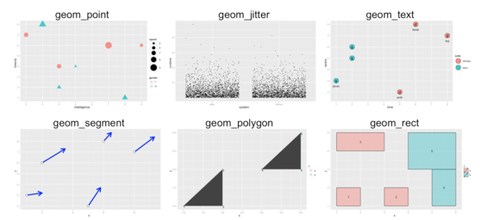
Key concepts – Geometric objects
Specifies how the aesthetics are displayed
Using functions beginning with geom_

Slide 11
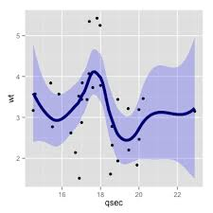
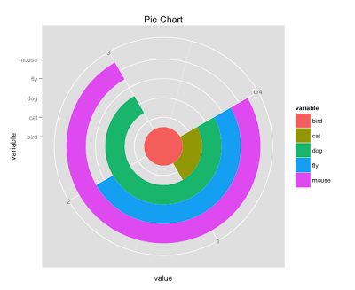
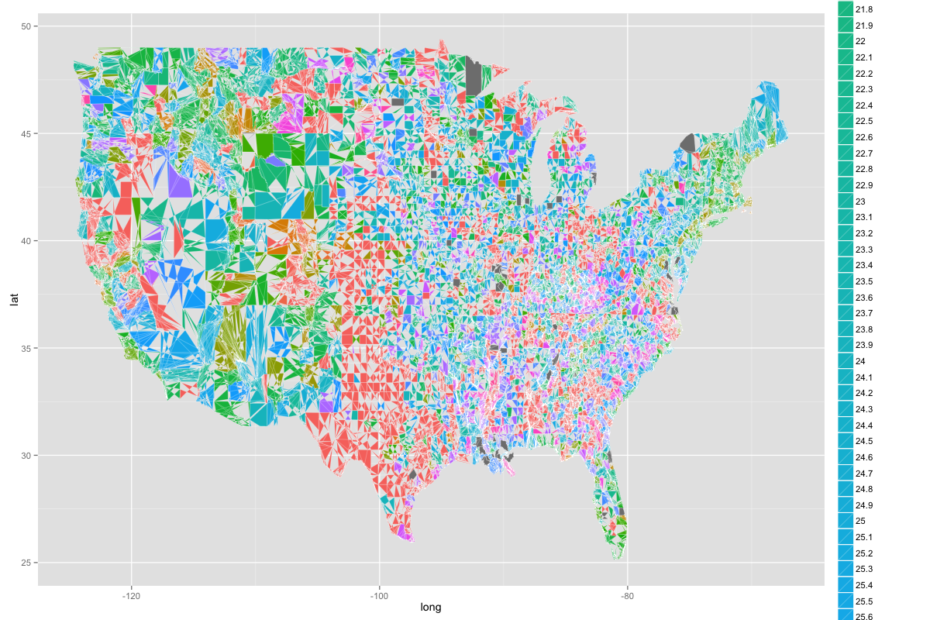
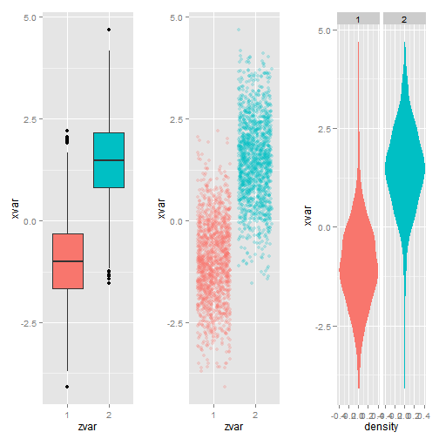
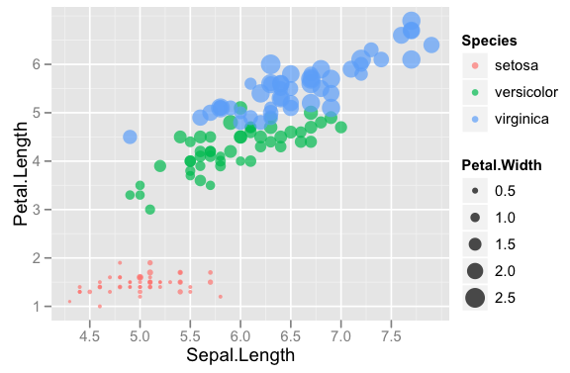
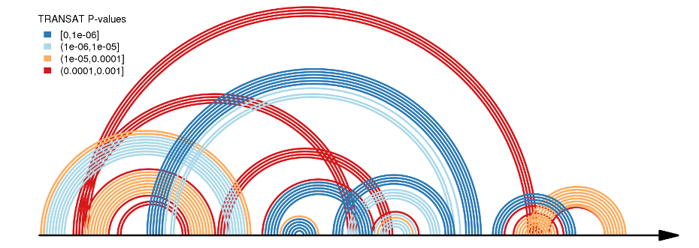
Countless capabilities…

Slide 12
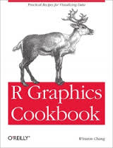
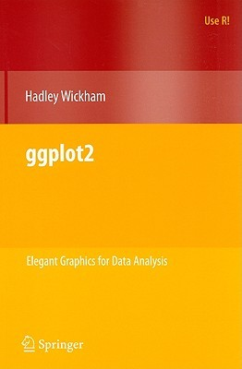
Also check out online resources!
The ggplot website is great, but there are many to choose from.

Slide 13
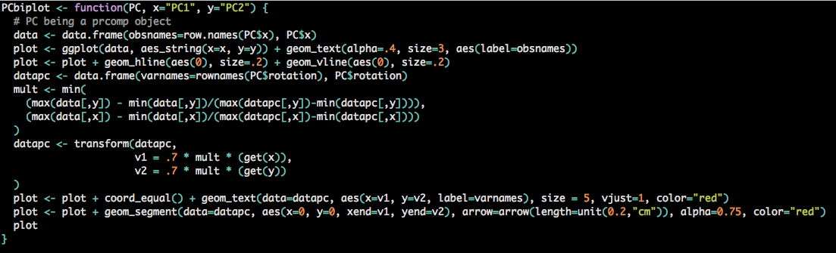
Next week…
Writing a function

